Slide 1
Object Detection using Deep Learning with Audio Feedback
UNDER THE ESTEEMED GUIDANCE OF
Mrs.M.RUPA SRI
PRESENTED BY
Y.DURGA PRASAD(322228820129)
MCA

Slide 2
CONTENTS OF PPT
Abstract
Introduction
Existing System
Proposed System
Software Requirements
Hardware Requirements
Libraries
CNN
YOLO Model & TTS
COCO
Results
Conclusion

Slide 3
ABSTRACT
Object detection is a computer vision task that involves identifying and locating objects in images or videos. This is a challenging task, as objects can vary in appearance, size, and pose. In recent years, deep learning has revolutionized object detection, enabling real-time detection of objects with high accuracy. Deep learning has enabled real-time object detection with high accuracy. This is due to the fact that deep learning models can learn to identify objects from large datasets of labeled images. This allows deep learning models to generalize to new objects and situations, which is essential for real-time object detection.

Slide 4
INTRODUCTION
The project aims to explore the cutting-edge advancements in deep learning algorithms and methodologies to develop a highly efficient and accurate object detection system.
By harnessing the potential of deep learning, this project endeavors to overcome the limitations of traditional computer vision techniques and pave the way for more intelligent and responsive applications.
The primary focus of this project is to design and implement a real-time object detection system that can analyze and recognize objects in images or video streams at an impressive speed without compromising on accuracy.
We will delve into the principles behind deep learning models for object detection, understanding the underlying architecture and the mathematics that drive their capabilities.

Slide 5
Existing System
Object detection using deep learning typically relies on visual input, where convolutional neural networks (CNNs) are commonly used to analyze images or video frames to detect and classify objects within them.
However, integrating audio feedback into the object detection process is less common but certainly feasible and potentially useful in certain applications.

Slide 6
Proposed System
Incorporating audio feedback into object detection using deep learning could involve the following steps:
Audio Feedback Integration: Develop a system interface that provides audio feedback based on the object detection results. This could involve generating spoken descriptions of detected objects or using audio cues to alert users about the presence of certain objects.

Slide 7
Software Requirements
Environment: Python
Tool: Jupyter Notebook and Anaconda Prompt
Operating system: Windows11
Edition: Windows 11 Home Single Language
Version: 22H2
OS build: 22621.2134

Slide 8
Hardware Requirements
Name: DESKTOP-J7D8Q2I
Processor: Intel(R) Core(TM) i3-1005G1 CPU @ 1.20GHz 1.20 GHz
RAM: 8.00 GB
System type: 64-bit operating system, x64-based processor
Storage: 512Gb SSD

Slide 9
LIBRARIES
OpenCV
It is a powerful library that can be used for a variety of tasks, including image processing, video processing, and object detection.
PyTorch
It is a dynamic library, which means that it can be used to create both static and dynamic neural networks. This makes it a flexible tool that can be used for a variety of tasks.
Pyttsx
Pyttsx is a Python library that provides text-to-speech capabilities.

Slide 10
ALGORITHM
Convolutional Neural Network (CNN): A deep learning model designed for image recognition, using convolutional layers to automatically and adaptively learn patterns, widely used in computervision tasks.
The CNN process the input image through multiple convolutional layers.Each convolutional layer applies a set of filters such as edges, textures and shapes.

Slide 11
MODEL
YOLO (You Only Look Once)
YOLO (You Only Look Once) is a family of object detection algorithms that are based on the single-shot detection (SSD) framework. YOLO algorithms are known for their speed and accuracy, and they are widely used in a variety of applications, such as self-driving cars, surveillance, and robotics.
The state-of-the-art real-time object recognition model known as YOLOv5, or "You Only Look Once, Version 5," has become extremely well-liked in the computer vision and deep learning fields. The YOLOv5 algorithm, created by Ultralytics, builds on the success of its forerunners and offers notable enhancements in terms of speed, accuracy, and variety.

Slide 12
Python Text-to-Speech (TTS)
PyTTSx3 is a popular Python Text-to-Speech (TTS) engine that allows developers to turn written text into natural-sounding speech. PyTTSx3 has been a popular alternative for designing apps that require voice synthesis due to its ease of use and flexibility.
The simplicity of usage of PyTTSx3 is one of its most important benefits. With just a few lines of Python code, developers may immediately incorporate it into their applications. By providing customization options for speech rate, volume, and pitch control, it enables developers to precisely tailor the generated speech to the requirements of their application.
Additionally, Pyttsx3 gives you the option to save the generated speech as audio files in a variety of formats, including WAV or MP3. If you wish to programmatically produce audio books, voiceovers, or other audio content, this option is quite helpful.

Slide 13
DATASETS
COCO (Common Objects in Context)
The COCO.names file contains the labels that the coco dataset contains and to know what labels present in it.
This predicts an object with certain class index(example : 0 for person,1 for cellphone…) to convert this index into a readable label.
The dataset was created by Microsoft and is used to train and evaluate object detection, segmentation, and captioning algorithms.

Slide 14
RESULTS
The results of the code is to detect objects in real time and display them on the screen. The code will use the YOLO model to detect objects and the pyttsx3 library to provide text-to-speech feedback.
When the code is run, it will open the camera or video stream. It will then start to detect objects in the current frame. If an object is detected, the code will draw a bounding box around the object and display the object's name and confidence score. The code will also provide text-to-speech feedback, stating the name of the object that was detected.

Slide 15
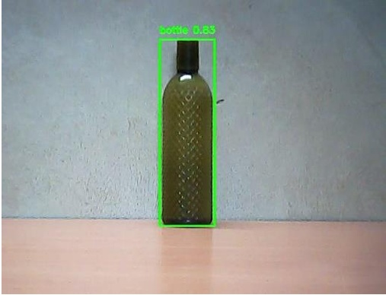
Performance results on Single Object

Slide 16
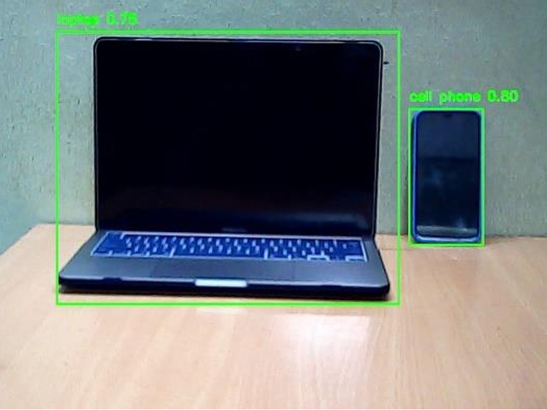
Performance results on Two Objects

Slide 17
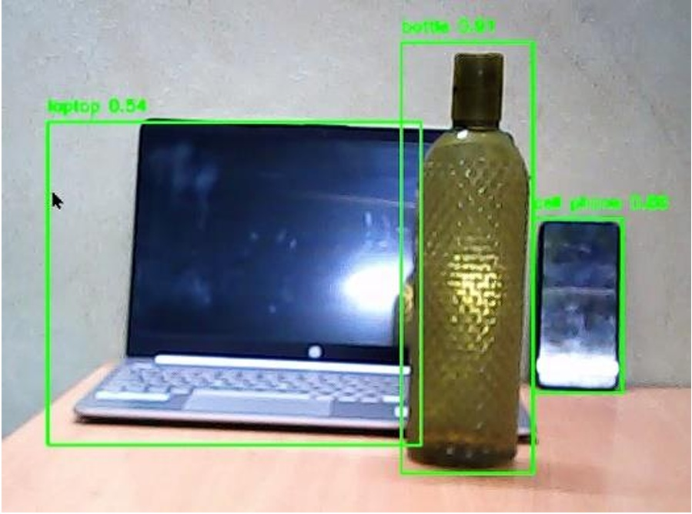
Performance results on Multiple Objects

Slide 18
CONCLUSION
In conclusion, the project has contributed to the advancement of computer vision and object detection by harnessing the power of deep learning for real-time applications. The knowledge gained throughout this project can serve as a foundation for building more intelligent and responsive systems that can comprehend and interact with the visual world in real-time. As the field of deep learning continues to evolve, we look forward to witnessing further breakthroughs in real-time object detection and its transformative impact on a wide range of industries and applications.

Slide 19
THANK YOU!

